Slide 1
MALLADI NARENDRA College name-NRI Institute of Technology
Final Project

Slide 2
PROJECT TITLE
Keylogger and Cyber Security

Slide 3


AGENDA
Problem Statement
Overview of the Project
Identifying the End Users
Solution and value proposition
Wow in Your Solution
ModelingWire Frames
Outputs
Results
GitHub Link
3/21/2024 Annual Review

Slide 4

PROBLEM STATEMENT
To address the growing threat of keyloggers, this project aims to develop advanced detection mechanisms capable of identifying and neutralizing malicious keylogging activities. The system must ensure real-time monitoring of keystrokes across various platforms while preserving user privacy and data integrity. By implementing robust encryption techniques and proactive security measures, the solution seeks to provide users with a reliable defense against keylogger-based attacks, thereby enhancing overall cybersecurity posture.

Slide 5

PROJECT OVERVIEW
Objective: Develop a robust system to address security concerns related to keyloggers.
Focus: Detection, prevention, and mitigation of keylogger threats.
Key Components:
Advanced detection algorithms for real-time monitoring of keystroke activities.
Implementation of strong encryption techniques to safeguard sensitive data.
Proactive defense mechanisms to prevent unauthorized access and misuse.
Outcome: Enhanced cybersecurity posture through effective protection against keylogger-based attacks.
Impact: Improved user confidence in data security and privacy across various platforms.

Slide 6

WHO ARE THE END USERS?
The end users of the "Keylogger and Security" project can vary depending on the specific implementation and scope of the system. Generally, they may include:
Individual Users: Individuals concerned about protecting their personal information and privacy on their devices.
Businesses and Organizations: Enterprises looking to secure sensitive corporate data and prevent unauthorized access through keylogging activities.
Government Agencies: Agencies aiming to safeguard classified or sensitive information from espionage and cyber threats.
Educational Institutions: Schools and universities needing to protect student and faculty data from unauthorized access and privacy breaches.
Security Professionals: Cybersecurity experts and IT professionals responsible for maintaining and securing network infrastructure and systems against keylogger threats.
The project's end users encompass a broad spectrum, ranging from individual consumers to large organizations, all seeking to mitigate the risks associated with keyloggers and enhance overall data security and privacy.

Slide 7
YOUR SOLUTION AND ITS VALUE PROPOSITION
Our solution, "Keylogger and Security," is designed to address the pervasive threat posed by keyloggers with a focus on detection, prevention, and mitigation. Here’s how we provide value:
Advanced Detection Technology: We employ cutting-edge algorithms and behavioral analysis techniques to detect and identify keylogger activities in real-time across various operating systems and applications.
Robust Prevention Mechanisms: Our system integrates proactive measures to prevent keyloggers from capturing sensitive keystrokes, including sandboxing techniques, anomaly detection, and heuristic analysis.
Data Encryption and Privacy: Strong encryption methods are implemented to protect captured keystroke data, ensuring confidentiality and preventing unauthorized access.
Comprehensive Security: By enhancing cybersecurity defenses against keylogger threats, our solution helps maintain data integrity, protects against identity theft, and safeguards sensitive information across all user interactions.
Scalability and Adaptability: Designed to scale with evolving threats and technological advancements, our solution remains adaptable to new keylogger variants and emerging security challenges.
Overall, "Keylogger and Security" provides a robust defense against keylogger threats while ensuring user privacy, data integrity, and operational continuity across diverse user environments.

Slide 8

THE WOW IN YOUR SOLUTION
AI-Powered Threat Recognition: Harnesses cutting-edge artificial intelligence algorithms to swiftly identify and neutralize even the most sophisticated keyloggers, ensuring unparalleled protection.
Adaptive Behavioral Analysis: Utilizes dynamic behavioral analysis techniques to detect anomalies in typing patterns, effectively differentiating between legitimate and malicious keystroke activities.
Real-Time Adaptive Defense: Employs adaptive defense mechanisms that evolve in response to emerging keylogger tactics, ensuring continuous protection against evolving cyber threats.
Comprehensive Security Assurance: Provides a holistic approach to cybersecurity by integrating advanced detection, prevention, and response capabilities, delivering unparalleled peace of mind to users and organizations alike.
This solution sets a new standard in keylogger defense, combining cutting-edge technology with user-centric design to deliver exceptional security and reliability.

Slide 9
MODELLING
Install required python libraries in command prompt like,
1. pip install pynput 2. pip install json
Initialization of keylogger : Set up the main GUI window. Initialize global variables for key logging.
Capturing of keystrokes : Start capturing key events when the "Start" button is pressed. Log key press and release events.
Data Logging into text files : update text and Json log files with captured key events.
Stop Logging : Stop capturing key events when the "Stop" button is pressed.

Slide 10
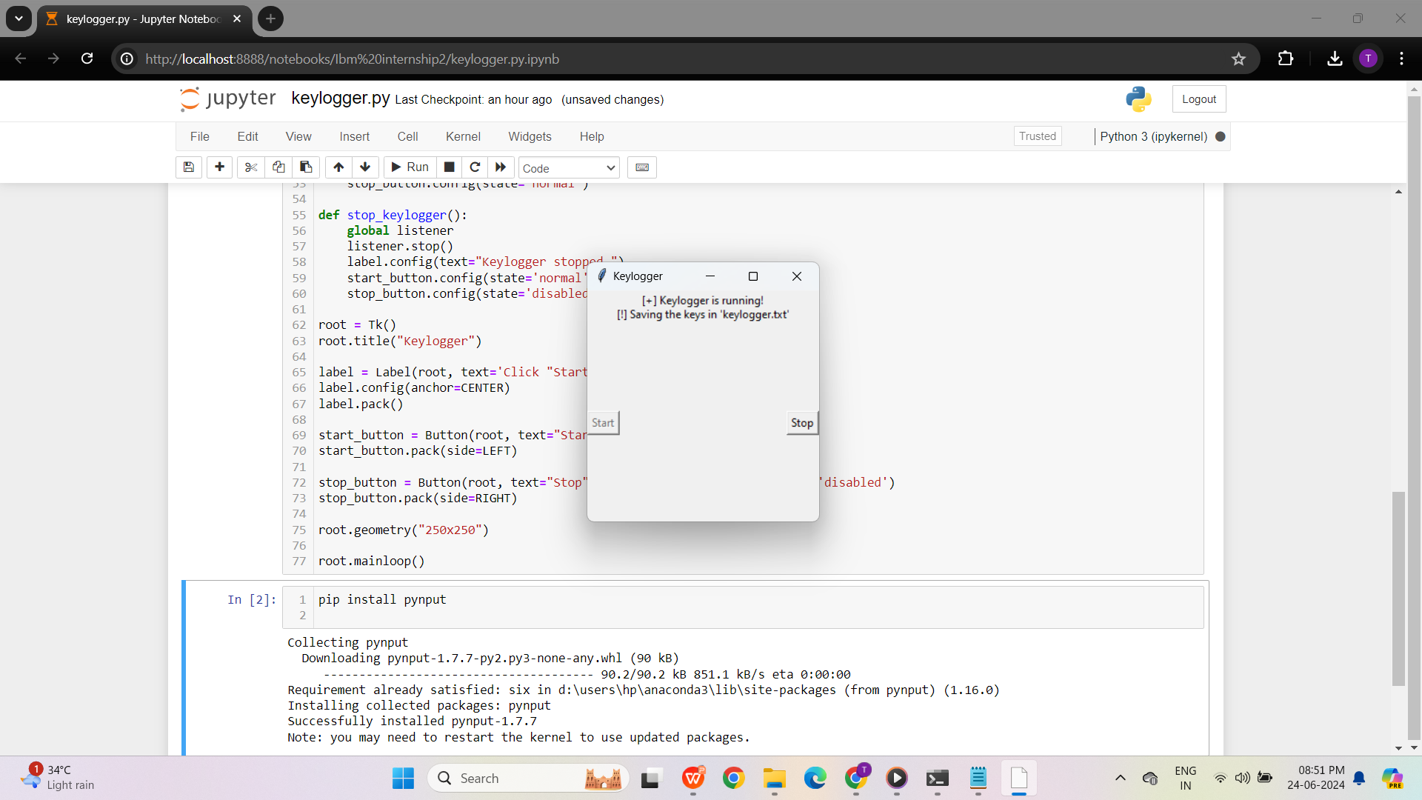
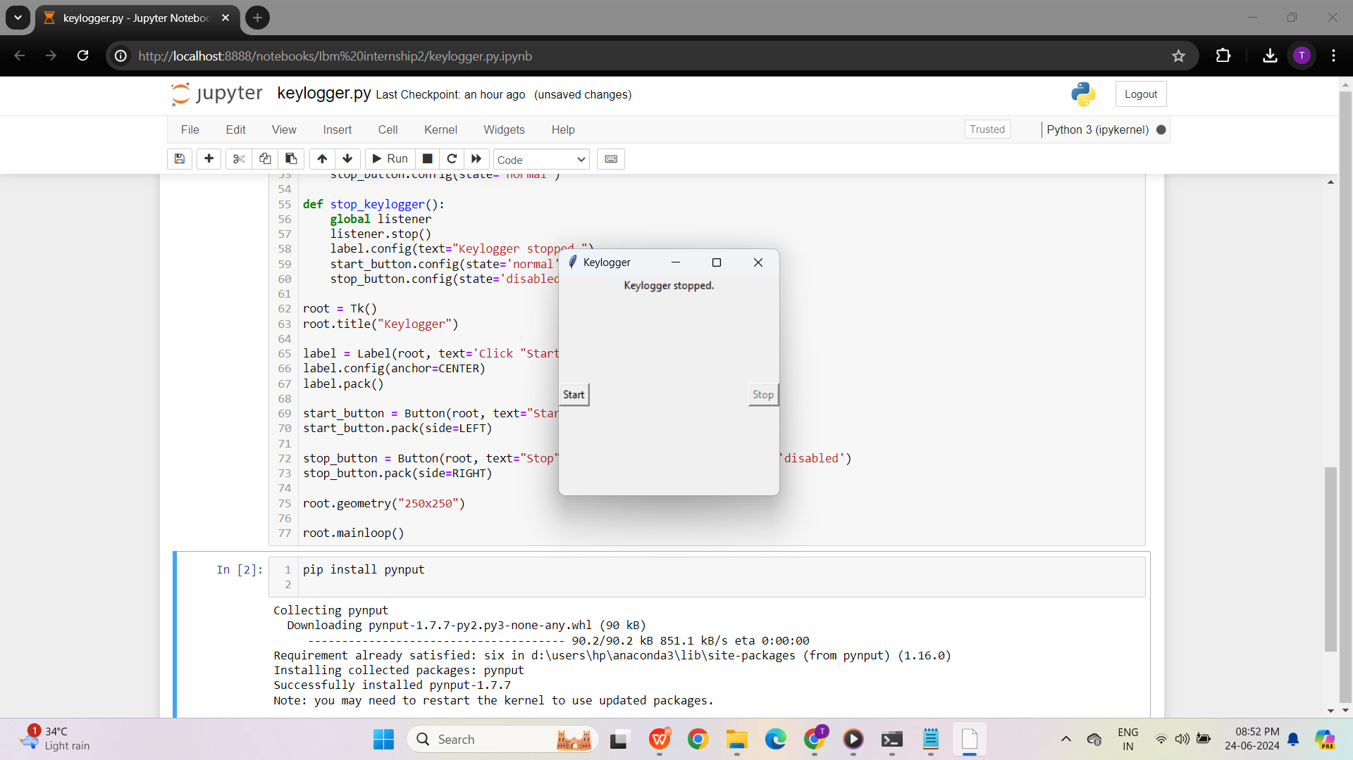
Output
START STOP
________________________

Slide 11
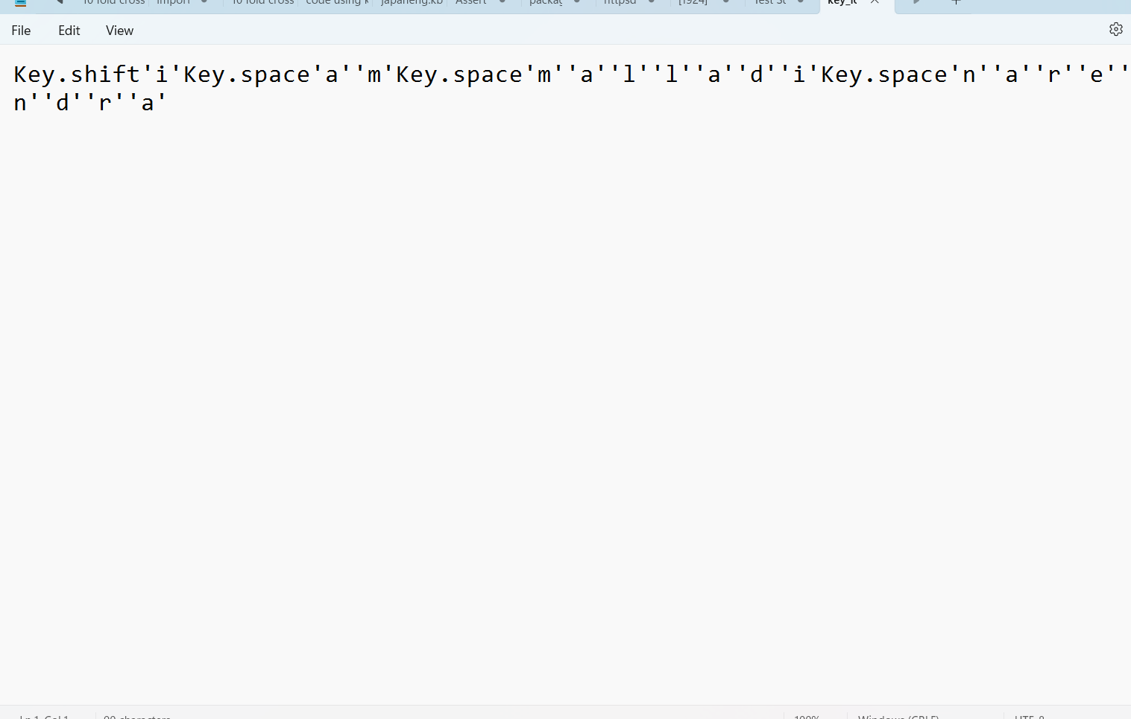
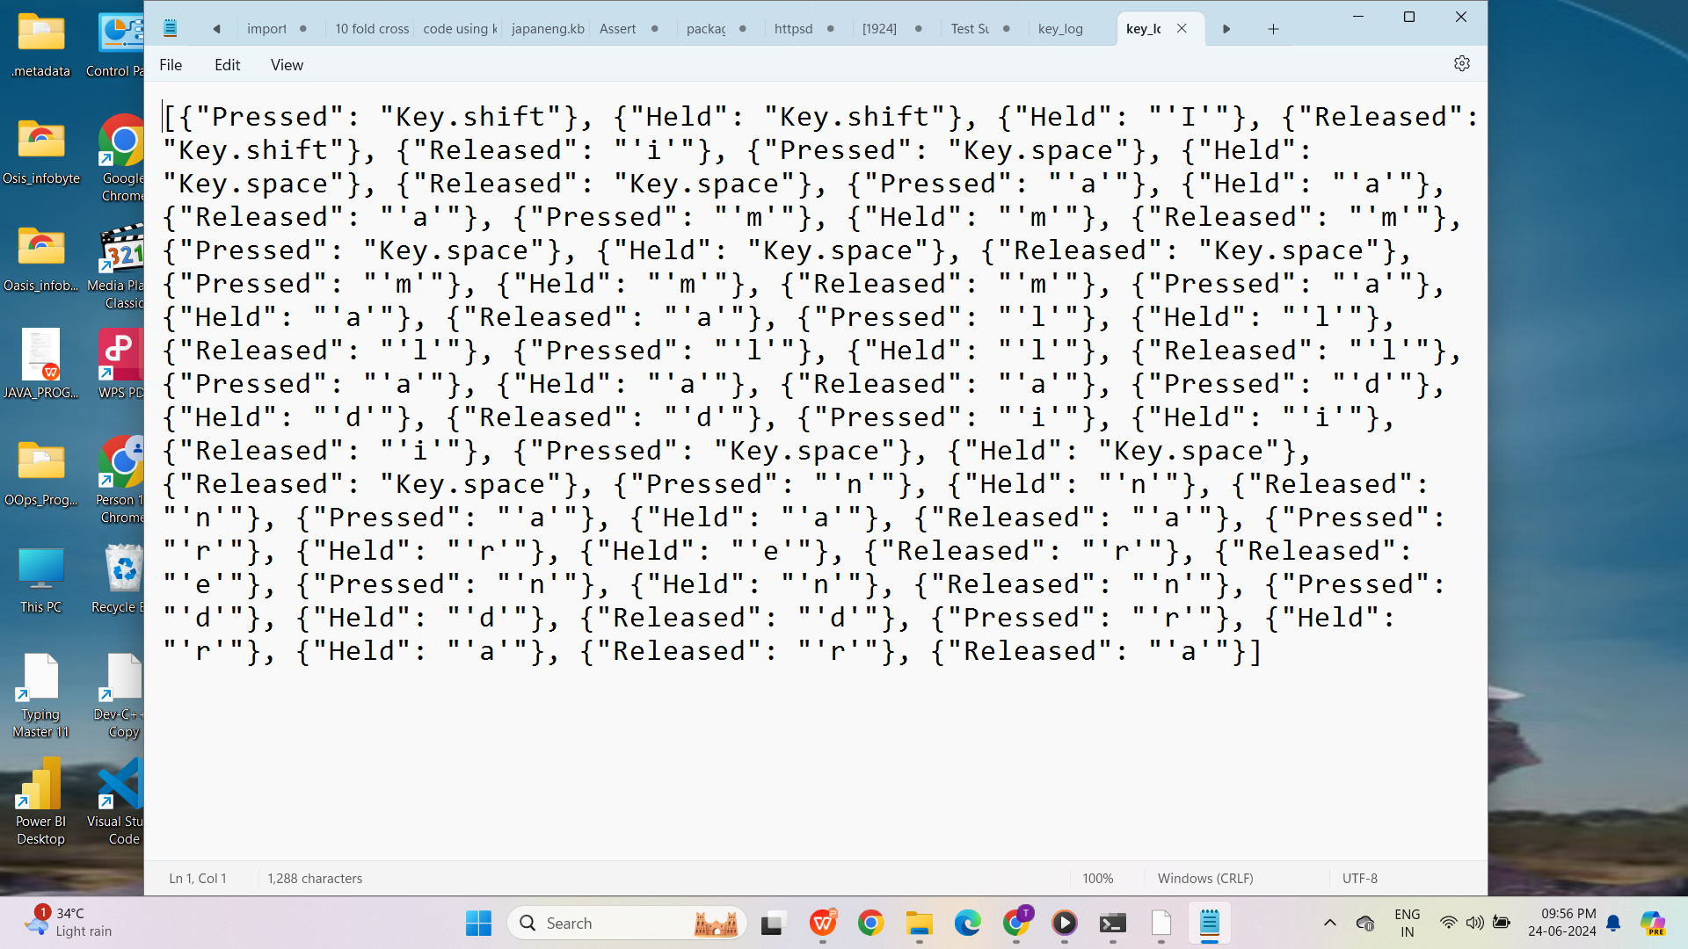
RESULTS
key_log.txt
key_log.json
________________________

Slide 12
GitHub Link
https://github.com/MALLADINARENDRA/cyber-security-project

Slide 13


